Slide 1
Project Pulse
Alpha Overview

Slide 2
Future Infrastructures Are Software Defined
Future Infrastructures Are Software Defined
Cloud Computing is the next generation computing model for service delivery
1960s
1990s
2000s
2010s
Mainframes
Client + Server
Web
Cloud

Slide 3
Cloud Computing Growth & Market Dynamics
Cloud computing is the fastest growing segment of the data center business
52% CAGR
Annual Intel CPU Sales
Private Cloud
Tier 2 CSP
Tier 1 CSP
2009
2010
2011
2012
2013
2014
Intel Internal Only

Slide 4
Intelligent Resource Orchestration
LEARN
WATCH
Expose platform/app data through APIs
COLLECT
DECIDE
Analytics to define correct response
WATCH
DECIDE
ACT
LEARN
LEARN
ACT
Mechanisms for policy activation
APP
SERVER / STORAGE / NETWORK
LEARN
Machine learning for continuous improvement
LEARN

Slide 5
Technologies that help us shape the cloud
Cloud Software Stack
Applications & Services
Cloud
Software
Developer Environment
Telemetry and
Datacenter Analytics
Orchestration Software
Virtualization Software
Operating System, Libraries
Server
Silicon
Network
Silicon
Storage
Silicon

Slide 6
Assumptions for building Pulse
Platform telemetry can influence infrastructure management for new cloud stacks.
Exposing IA telemetry both enables #1 and creates Intel value via unique platform telemetry.
Historically IA telemetry has been exposed in a limited, non-uniform, and difficult to consume format for cloud platforms.
Making IA telemetry easy to consume for a broad set of cloud use cases will drive preference for IA.

Slide 7
Pulse Overview – What is it?
A powerful telemetry agent framework designed to
Improve deployment model and flexibility of the telemetry tools ecosystem
Provide dynamic control of collection for small or large clusters of systems
Allow flexible processing of telemetry data on agent (e.g. machine learning)
Simplify disseminating data to telemetry ingesting systems
Provide operational innovation for collecting across cluster of machines
Support emerging API consumption models

Slide 8
Pulse Overview – What it isn’t
Pulse is not intended to
Operate as an analytics platform – It is intended to feed them
Compete with existing metric/monitoring/telemetry agents

Slide 9
The Workflow
Process and normalize
Publish into domains
Collect data
Orchestration & Scheduling
Filter
Learn
Monitoring
Convert
Billing/Chargeback

Slide 10
The Plugin Model
Collector
Processor
Publisher

Slide 11
Pulse Overview – Collect
Consume telemetry data through plugins
Built-in plugins for leveraging existing telemetry ecosystem (Facter, CollectD, Ohai)
Specific plugins for consuming Intel telemetry (Node, DCM, NIC, Disk)
Open model for third party plugins
Organized telemetry catalog dynamically generated from plugins
Make discovering available telemetry easy through dynamic documentation, APIs, and more
Make consuming telemetry declarative
Notes:
Updated by NW – 4/14

Slide 12
Pulse Overview – Process
Extensible workflow injection
Convert telemetry into another data model for consumption by existing telemetry consumption systems (like OpenStack Ceilometer)
Allows encryption of all or part of the telemetry payload before publishing.
Inject remote queries into workflow for tokens, filtering, etc.
Implement filtering at an agent level reducing injection load on telemetry consumer
Notes:
Updated by NW – 4/14

Slide 13
Pulse Overview – Publish
Sink telemetry into a wide array of systems
Decouple the collection of IA telemetry from the implementation of where to send it.
A large library of publisher plugins allow exposure to telemetry analytics systems both customer and common.
Makes Pulse valuable in the way it enables and cooperates with existing systems.
Make Pulse valuable to open source and commercial ecosystems by allow them to build a publisher into their architectures.
Notes:
Updated by NW – 4/14

Slide 14
The Catalog
Expose telemetry in a unified catalog
/intel/server/cpu/load
/intel/server/cpu/ipc
/intel/server/cpu/l2cache
Intel NIC
Intel IPC
Intel MEM
/intel/server/mem/free
/intel/server/mem/used
/intel/server/nic/eth0/bytes_rec
Query: Show me all “/intel/server/*”

Slide 15
Example
Influx & Grafana
OpenStack Ceilometer
OpenStack Ceilometer
OpenStack Ceilometer
OpenStack Oslo
Adapter
OpenStack Oslo
Adapter
OpenStack Oslo
Adapter
RabbitMQ
RabbitMQ
Metric Query
Publisher
Metric Query
Metric Query
Collector
RabbitMQ
Processor
NIC
NIC
CPU
CPU
CPU
MEM
MEM
MEM
Publisher

Slide 16
Plugin Lifecycle
Plugin load
Dynamic, does not require restart
Automatically is informed by plugin on the features, metrics, and configuration detail.
Dynamically extends the metric catalog when loaded.
Plugin unload
Removes metrics from catalog automatically.
Plugin swap
Swaps a newer version plugin for an old one in a safe transaction

Slide 17
Plugin Lifecycle
Loading a new plugin automatically upgrades running workflows in tasks.
Unless the collection is pinned to a version (ex: get /intel/server/cpu/load/v1)
Each scheduled workflow automatically uses the most mature plugin for that step.
Coupled with dynamic plugin loading results in instantaneous updates to existing workflows.
Helpful for bug fixes, security patching, improving accuracy.

Slide 18
Open Plugin Ecosystem
Intel Built-in
IA specific exposure of telemetry
Common processing hooks: OSLO, Machine Learning, Filtering
Common open source bus and persistent models: RabbitMQ, ,Mosquito, File, DB

Slide 19
Open Plugin Ecosystem
Support for external open source plugins
Plugins are built isolated from pulse itself
Allows ecosystem to add plugin building for specific projects into the project.
Plugins can be built externally and loaded/shared widely.

Slide 20
Open Plugin Ecosystem
Commercial plugin use supported
Plugin can be distributed
Once built the plugins can be shared as part of a commercial product licensed separately from Pulse.
Works well for vendors like VMware, SAP, etc.
Binary builds keep source code private.

Slide 21
The API
Current:
Full control through REST API on pulsed
pulsectl CLI tool for managing pulsed remotely
REST API support for HTML5 SSE streaming
Beta
TRIBE (management clustering)
Webconsole

Slide 22
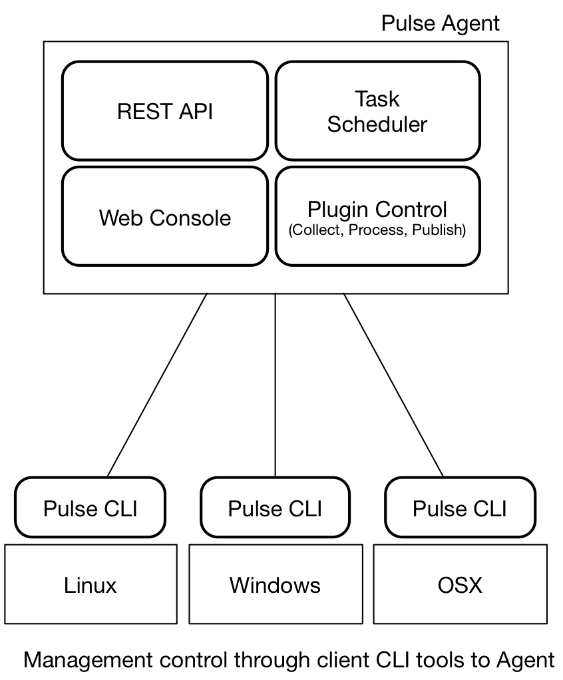
Notes:
Remove non-pertinent modules from pulse agent

Slide 23
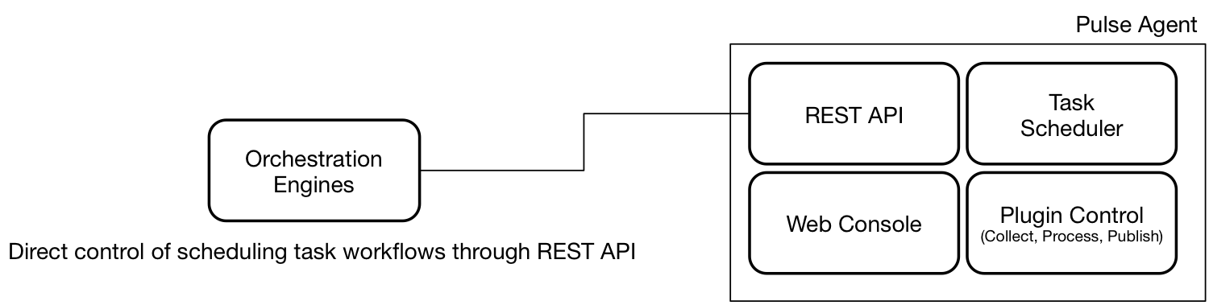
Notes:
Expand w/ use cases, openstack, vco, kuber
Add Configuration management ex, puppet, anisble, etc

Slide 24
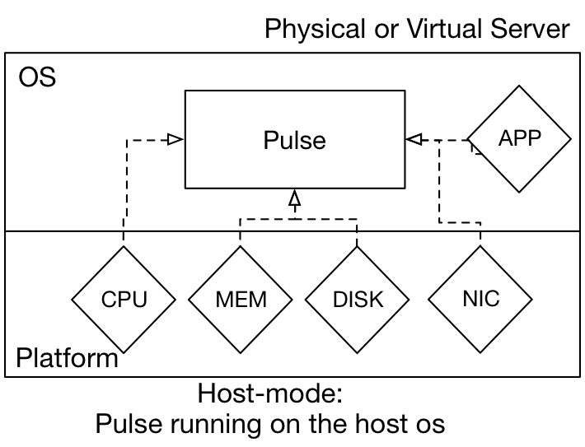
Flexible deployment

Slide 25
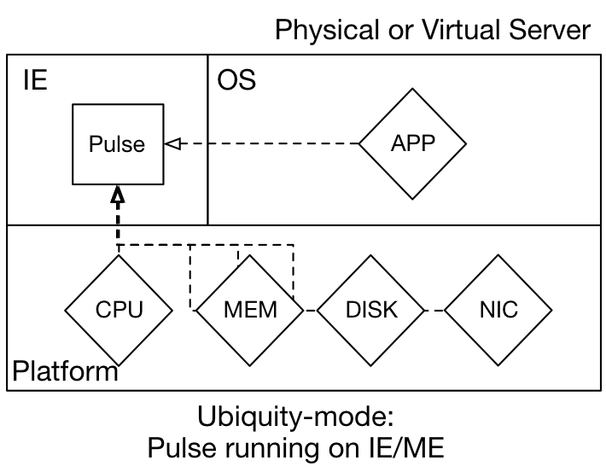
Flexible deployment
Notes:
IE- Innovation engine

Slide 26
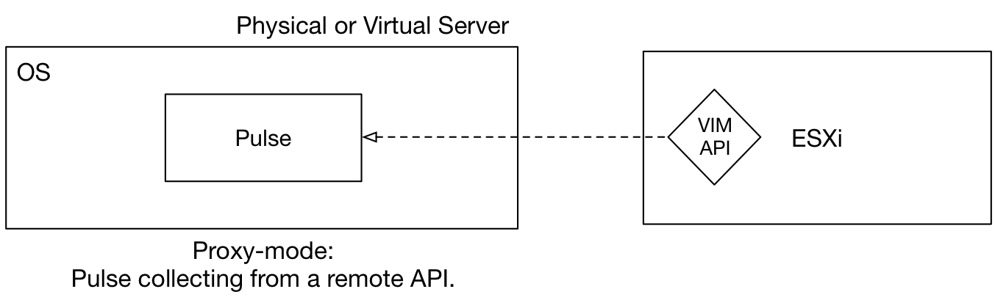
Flexible deployment

Slide 27
Example Deployment Scenarios
Host: Physical/VM
All-in-One
Distributed And Decoupled
Collection
Host: Physical or Virtual
Scheduler
Host: Physical/VM
Host: Physical/VM
Host: Physical/VM
Host: Physical/VM
Collection
Processing
Scheduler
Collection
Processing
Publishing
Publishing
Host: Physical/VM
s
Collection

Slide 28
DEMO

Slide 29
Next Steps
Demos to our demo guest list (Intel internal)
Beta phase
Flexible deployment model
TRIBE clustering
AAA (security)
Plugin signing
Other features, based on feedback

Slide 30
Create Value, Creating Preference for IA
Make unique telemetry from Intel Architecture available and easy to consume
Tie telemetry to smarter decisions (better workload placement, more efficiency, predictive systems)
Associate developing on IA with ease of use & decrease in OpEx
Drive discussion for future platforms & develop insight for what telemetry is valuable.

Slide 31
Create Value, Creating Preference for IA
Make unique telemetry from Intel Architecture available and easy to consume
Tie telemetry to smarter decisions (better workload placement, more efficiency, predictive systems)
Associate developing on IA with ease of use & decrease in OpEx
Drive discussion for future platforms & develop insight for what telemetry is valuable.
Attach silicon value & avoid abstraction
MSS & ASP expansion and protection
Notes:
-graphical representation???

Slide 32







Deployment Models
Open Platform - Full Open Source (Apache license)
Pulse agent code distributed and supported in open source community
Intel-supported plugins packaged and licensed with platform
Community plug-ns expected to be developed independent of Intel
SDK published and maintained by Intel
Integration work for Openstack Ceilometer and Docker ecosystem
Can be integrated by CSPs (e.g. Cloud Foundry)
Proprietary Platform - Enable OEM & ISV differentiation (VMWare, SAP)
Pulse agent code distributed by ISV, ecosystem partners, or deployed directly by end customer
Option for ISV ecosystem partners to create custom/proprietary plug-ins
Custom Platform – Enable large scale datacenter and service provider solutions
Pulse plug-ins developed by each customer for their unique platform
Allows custom consumer to specialize above or alongside supported or community plugins
AWS, Google, Digital Ocean

Slide 33
Pulse Overview – Publish
Capable of publishing data to single or multiple endpoints
RabbitMQ
Ceilometer
vCops
InfluxDB

Slide 34
Pulse Overview – Example Workflows
Customizable definition of task and related workflow:
Collect
Publish
Collect
Process
Publish
Publish
Process
Publish
Collect
Collect
Publish
Process
Publish

Slide 35
Pulse Overview – Architecture
Core framework for scheduling and workflow management
Plugins make Pulse
Pulse is extensible through plugins for collection, processing, and publishing of metric data

Slide 36
Pulse Overview – Core Architecture
Scheduler
Create/Delete tasks
Schedule tasks
Manage Plugins
Types: Collect, Process, Publish
Load/Unload plugins
Catalog metrics
Start/Stop plugins
Rest API

Slide 37
Simple and Flexible Deployment
Simple Deployments
A single binary to install the framework
Scheduling tasks, Collection, Processing, Publishing
Plugins can be automatically detected
Flexible Deployments
Easy all-in-one
Scheduling tasks, Collecting, Processing and Publish on a single host
Distributed
Components can be deployed independently on separate hosts
Enables complex scenarios
processing and publishing for a group of hosts go through specific hosts

Slide 38
Example Deployment Scenarios
Host: Physical/VM
All-in-One
Distributed And Decoupled
Collection
Host: Physical or Virtual
Scheduler
Host: Physical/VM
Host: Physical/VM
Host: Physical/VM
Host: Physical/VM
Collection
Processing
Scheduler
Collection
Processing
Publishing
Publishing
Host: Physical/VM
s
Collection

Slide 39
API Enabling Custom Integration
API
Define tasks and workflows
Collect -> Process -> Publish
Select schedule (Interval, Window, Cron)
Manage plugins
Load/Unload/Swap
Stop/Start
Hits, Misses, Errors
Set plugin routing strategy (round-robin, most recently used, …)
File
Configuration files
Define tasks and workflows
Configure plugins
Notes:
Example integrations
New host is provisioned
Pulse is deployed by the native configuration capability
Host is provisioned
OpenStack, AWS, bare metal
Pulse is installed via native installer and configuration tool
cloud-init, Puppet, Chef, etc
Pulse is configured through either config file(s) or through direct API calls
Puppet runs a manifest that installs pulse, starts service and configures it through API
Cloud-init install pulse along with config files and starts service
Ansible runs a playbook which installs pulls and config files
New service is provisioned
A new database is provisioned
An event triggers a program that integrates with pulse to schedule a new task to collect and publish usage metrics for the new db

Slide 40
Custom Integration
Host/VM is provisioned
Pulse is installed via native installer
Pulse is configured through either config file(s) or direct API calls
Notes:
New host is provisioned
Pulse is deployed by the native configuration capability
Host is provisioned
OpenStack, AWS, bare metal
Pulse is installed via native installer and configuration tool
cloud-init, Puppet, Chef, etc
Pulse is configured through either config file(s) or through direct API calls
Puppet runs a manifest that installs pulse, starts service and configures it through API
Cloud-init install pulse along with config files and starts service
Ansible runs a playbook which installs pulls and config files

Slide 41
Custom Integration
Event is created by X Service
Event is sourced by event consumer that integrates with Pulse through API

Slide 42
Flexible Locality
Notes:
Include a mapping machine learning – why we want to do processing in pulse

Slide 44
Notes:
IE- Innovation engine

Slide 46
Modular API Architecture

Slide 47
Decoupled Deployment Options

Slide 48
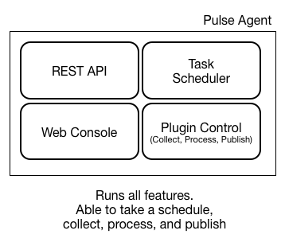
Notes:
Add plugin life cycle
Change to “Agent web console”

Slide 49
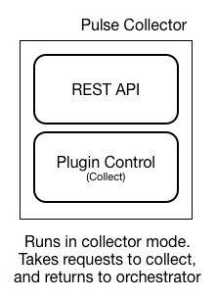
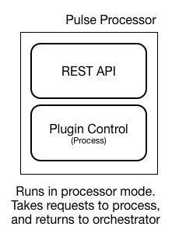
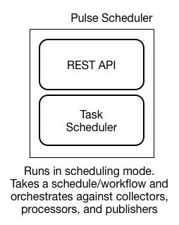
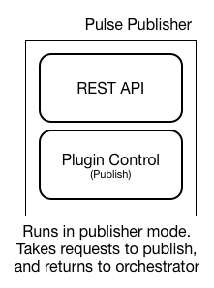
Notes:
Make a flow diagram/show flow examples
Wireless, sec, ex
DC/big picture flow
Differentiate b/w alpha and beta features

Slide 50
Simple Mockup – Web Console

Slide 51
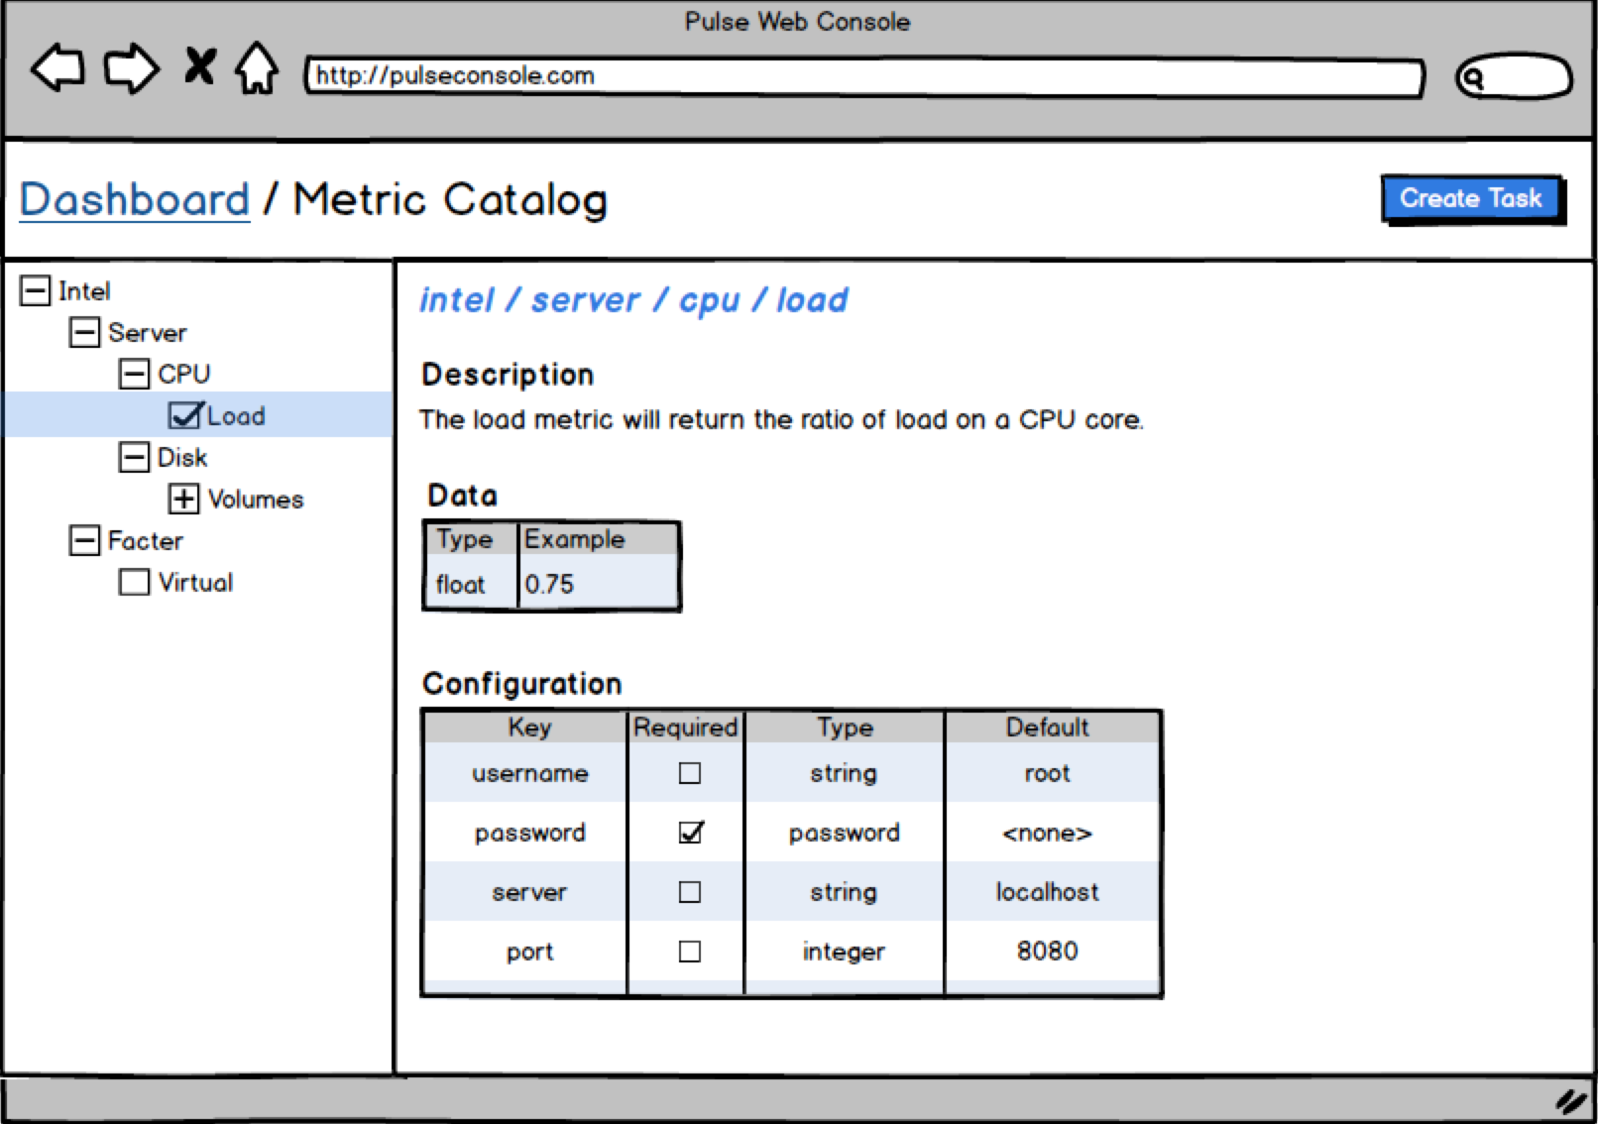
Notes:
Done w/ balsamic

Slide 52
Normal Collection Flow
Sensor
collect
Temp
Temp
Temp
Temp
Temp
Temp
Temp
Temp
68F
69F
68F
68F
80F
105F
100F
68F
Collector Plugin
Publisher Plugin
Consumer
consume
Temp
Temp
Temp
Temp
Temp
Temp
Temp
Temp
68F
69F
68F
68F
80F
105F
100F
68F
Notes:
Updated by NW – 4/14
Example: Machine learning processor plugin
Collect temperature data from server and send to processer plugin
Process temperature data
Learn baseline of data
Only publish data when outside of baseline
Removes duplicate or noisy data from network and reduces load on telemetry consumer

Slide 53
Using A Processing Plugin
Sensor
collect
Temp
Temp
Temp
Temp
Temp
Temp
Temp
Temp
68F
69F
68F
68F
80F
105F
100F
68F
Collector Plugin
Machine Learning Processing Plugin
Publisher Plugin
Consumer
consume
Temp
Temp
Temp
80F
105F
100F
Notes:
Updated by NW – 4/14
Example: Machine learning processor plugin
Collect temperature data from server and send to processer plugin
Process temperature data
Learn baseline of data
Only publish data when outside of baseline
Removes duplicate or noisy data from network and reduces load on telemetry consumer

Slide 54
Available Plugin Strategy
Available Plugin – a running instance of a loaded plugin
Plugin writers define “concurrency count”
This defines the number of Available Plugins to run according to the number of subscriptions to metrics that plugin is responsible for.
Stopped and started as subscription counts change
Notes:
The whole slide may be unnecessary. It contains details that are covered in the Routing Strategy slide, and also requires a deeper context into the architecture of pulse.
It feels a little design document to me, less presentation.

Slide 55
Routing Strategy
Examples:
Round robin
Most Recently Used (MRU)
Least Recently Used (LRU)
Load balancing and fairness to available plugins
Strategy can be changed per plugin pool and on the fly
Notes:
“scale down” use case:
Using MRU strategy, an available plugin can go cold where it is never (or very rarely) used. Being able to discern this in the system allows Pulse to stop that AP and not require the resources it’s using.
Conversely, a high hit count in a short time window can be used to auto scale up a pool

Slide 56
Routing Strategy: Automatic Scale Up
a high hit count in a short time window can be used to auto scale up a pool
Adding plugin instances allows for disparate tasks to execute concurrently across more plugin endpoints.
This has a significant positive impact on an individual task’s execution latency

Slide 57
Routing Strategy: Automatic Scale Down
Using MRU strategy, an available plugin can go cold where it is never (or very rarely) used.
Being able to discern this in the system allows Pulse to stop that AP and not require the resources it’s using.

