Slide 1


Some New Ideas in Memory System Design for Data-Intensive Computing
Onur Mutlu
onur@cmu.edu
September 4, 2014
ISTC-CC Retreat

Slide 2
Some New Ideas (This Year)
Specialization
  Heterogeneous Reliability Memory [DSN 2014]
  Heterogeneous Block Architecture [ICCD 2014]
Persistent Memory
  Loose Ordering Consistency for Persistent Memory [ICCD 2014]
  Transparent Consistency for Persistent/Hybrid Memory [in progress]
Memory Reliability/Security
  Row Hammer Problem in DRAM [ISCA 2014]
  Neighbor-Cell Assisted Error Correction in Flash [SIGMETRICS 2014]
  Error Mitigation for Intermittent DRAM Failures [SIGMETRICS 2014]
Memory Performance
  The Dirty-Block Index [ISCA 2014]
  DRAM Refresh-Access Parallelization [HPCA 2014]
  The Blacklisting Memory Scheduler [ICCD 2014]
  Exploiting Read-Write Disparity in Caches [HPCA 2014]

Slide 3
Memory Reliability Trends
Memory is becoming less reliable as its density increases with technology scaling
  Reduced retention times
  Increased vulnerability to disturbance
  New error types (e.g., due to inter-cell interference)
  …
Maintaining reliability is expensive in terms of
  Energy
  Performance
  Cost (TCO)

Slide 4
DRAM Scaling
DRAM technology scaling has provided many benefits
  Higher capacity
  Lower cost
  Reasonable energy
  DRAM scaling is becoming difficult due to reduced reliability
    ITRS projects DRAM will not scale easily below X nm

Slide 5
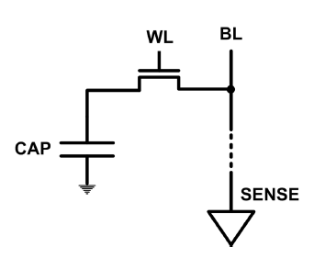
The DRAM Scaling Problem
DRAM stores charge in a capacitor (charge-based memory)
  Capacitor must be large enough for reliable sensing
  Access transistor should be large enough for low leakage and high retention time
  Scaling beyond 40-35nm (2013) is challenging [ITRS, 2009]
DRAM capacity, cost, and energy/power hard to scale

Slide 6
The DRAM Scaling Problem
DRAM scaling has become a real problem the system should be concerned about
  And, maybe embrace

Slide 7


Flipping Bits in Memory Without Accessing Them
DRAM Disturbance Errors
Yoongu Kim
Ross Daly, Jeremie Kim, Chris Fallin, Ji Hye Lee,
Donghyuk Lee, Chris Wilkerson, Konrad Lai, Onur Mutlu
Notes:
Hi, my name is Yoongu Kim. And today, I am presenting "Flipping Bits in Memory Without Accessing Them: An Experimental Study of DRAM Disturbance Errors." This is a work done in collaboration with my co-authors from Carnegie Mellon and Intel.

Slide 8
An Example of The Scaling Problem
Row of Cells
Wordline
Row
Victim Row
Row
Aggressor Row
V_{LOW}
Closed
V_{HIGH}
Opened
Row
Victim Row
Row
Repeatedly opening and closing a row induces disturbance errors in adjacent rows in most real DRAM chips [Kim+ ISCA 2014]

Slide 9
Quick Summary
We expose the existence and prevalence of disturbance errors in DRAM chips of today
  110 of 129 modules are vulnerable
  Affects modules of 2010 vintage or later
We characterize the cause and symptoms
  Toggling a row accelerates charge leakage in adjacent rows: row-to-row coupling
We prevent errors using a system-level approach
  Each time a row is closed, we refresh the charge stored in its adjacent rows with a low probability
Notes:
Here is a quick summary of our paper.
First, we expose the existence, and the prevalence, of disturbance errors in DRAM chips of today. Among 129 DRAM modules that we tested, we were able to induce errors in 110 modules, all of which were manufactured in 2010 or later.
Second, we characterize the cause and symptoms of disturbance errors. When a row is repeatedly toggled, we show that it accelerates the leakage of charge in adjacent rows, through a coupling effect between the rows.
Third, we prevent errors using a system-level approach. Each time a row is opened and closed, our idea is to refresh the charge stored in the adjacent rows with a low probability, thereby offsetting the leakage effect of disturbance.

Slide 10
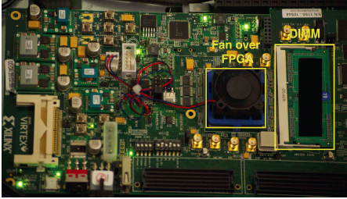
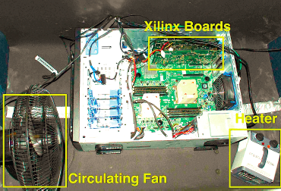
Experimental Infrastructure (DRAM)
  Liu+, “An Experimental Study of Data Retention Behavior in Modern DRAM Devices: Implications for Retention Time Profiling Mechanisms”, ISCA 2013.
  Khan+, “The Efficacy of Error Mitigation Techniques for DRAM Retention Failures: A Comparative Experimental Study,” SIGMETRICS 2014.

Slide 11
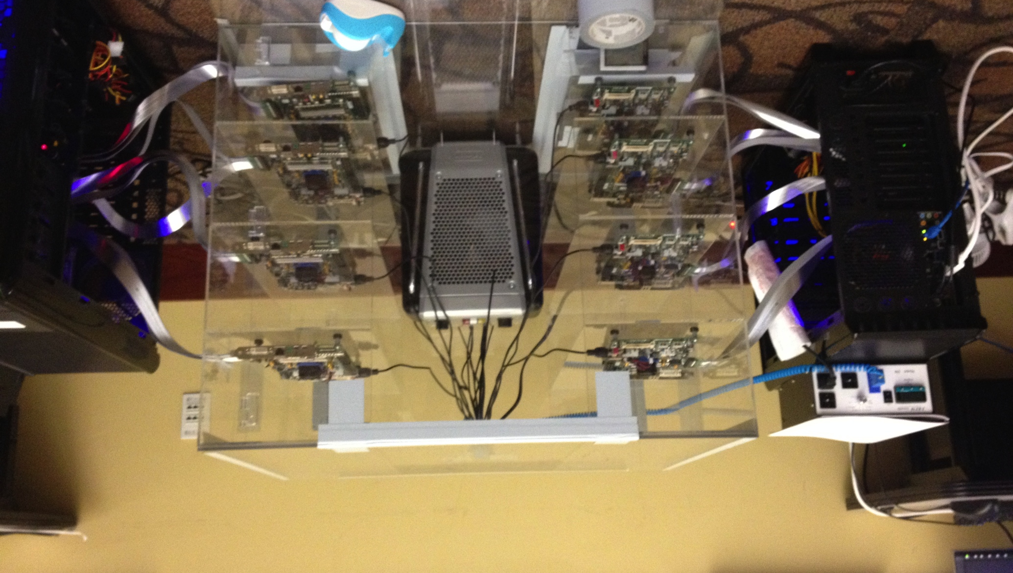
Experimental Infrastructure (DRAM)
Temperature
Controller
FPGAs
Heater
FPGAs
PC
  Kim+, “Flipping Bits in Memory Without Accessing Them: An Experimental Study of DRAM Disturbance Errors,” ISCA 2014.

Slide 12
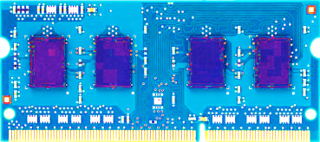
Most DRAM Modules Are at Risk
A company
B company
C company
86%
(37/43)
83%
(45/54)
88%
(28/32)
Up to
1.0×10⁷
errors
Up to
2.7×10⁶
errors
Up to
3.3×10⁵
errors
Kim+, “Flipping Bits in Memory Without Accessing Them: An Experimental Study of DRAM Disturbance Errors,” ISCA 2014.

Slide 13
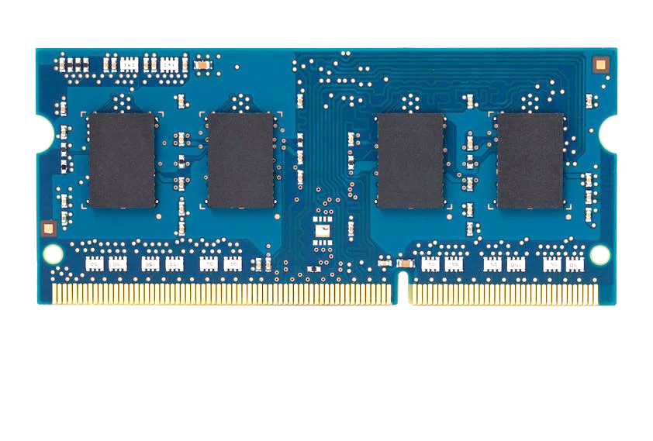
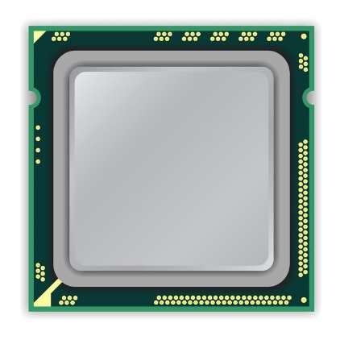
x86 CPU
DRAM Module
loop:
mov (X), %eax
mov (Y), %ebx
clflush (X)
clflush (Y)
mfence
jmp loop
X
Y
Notes:
We demonstrate the errors on multiple x86 systems. Shown to the bottom-left is a “disturbance kernel”. When executed, it forces two rows to be opened and closed one after the other – over and over again. Consequently, it induces many errors in the module.

Slide 14
x86 CPU
DRAM Module
loop:
mov (X), %eax
mov (Y), %ebx
clflush (X)
clflush (Y)
mfence
jmp loop
X
Y
Notes:
We demonstrate the errors on multiple x86 systems. Shown to the bottom-left is a “disturbance kernel”. When executed, it forces two rows to be opened and closed one after the other – over and over again. Consequently, it induces many errors in the module.

Slide 15
x86 CPU
DRAM Module
loop:
mov (X), %eax
mov (Y), %ebx
clflush (X)
clflush (Y)
mfence
jmp loop
X
Y
Notes:
We demonstrate the errors on multiple x86 systems. Shown to the bottom-left is a “disturbance kernel”. When executed, it forces two rows to be opened and closed one after the other – over and over again. Consequently, it induces many errors in the module.

Slide 16
x86 CPU
DRAM Module
loop:
mov (X), %eax
mov (Y), %ebx
clflush (X)
clflush (Y)
mfence
jmp loop
X
Y
Notes:
We demonstrate the errors on multiple x86 systems. Shown to the bottom-left is a “disturbance kernel”. When executed, it forces two rows to be opened and closed one after the other – over and over again. Consequently, it induces many errors in the module.

Slide 17
Observed Errors in Real Systems
In a more controlled environment, we can induce as many as ten million disturbance errors
A real reliability & security issue
CPU Architecture | Errors | Access-Rate
Intel Haswell (2013) | 22.9K | 12.3M/sec
Intel Ivy Bridge (2012) | 20.7K | 11.7M/sec
Intel Sandy Bridge (2011) | 16.1K | 11.6M/sec
AMD Piledriver (2012) | 59 | 6.1M/sec
Kim+, “Flipping Bits in Memory Without Accessing Them: An Experimental Study of DRAM Disturbance Errors,” ISCA 2014.
Notes:
When we executed the code on four different processors, all four of them yielded errors. Intel Haswell has the most errors, at 23 thousand, because it has the highest rate of accessing DRAM.
Later on, I’ll show that we can induce as many as ten million disturbance errors in a more controlled environment.
From this, we conclude that disturbance errors are a serious reliability issue.

Slide 18
Security Implications
Breach of memory protection
  OS page (4KB) fits inside DRAM row (8KB)
  Adjacent DRAM row → Different OS page
Vulnerability: disturbance attack
  By accessing its own page, a program could
  corrupt pages belonging to another program
We constructed a proof-of-concept
  Using only user-level instructions
Notes:
In addition, they have serious implications for security
When disturbance errors occur, they could breach memory protection. This is because an OS page fits inside a DRAM row. So an error in a different DRAM row means an error in a different OS page.
This opens up a vulnerability to disturbance attacks. Just by accessing its own page, a malicious program could corrupt pages belonging to another program.
And, as shown previously, we constructed a proof-of-concept using only user-level instructions.

Slide 19
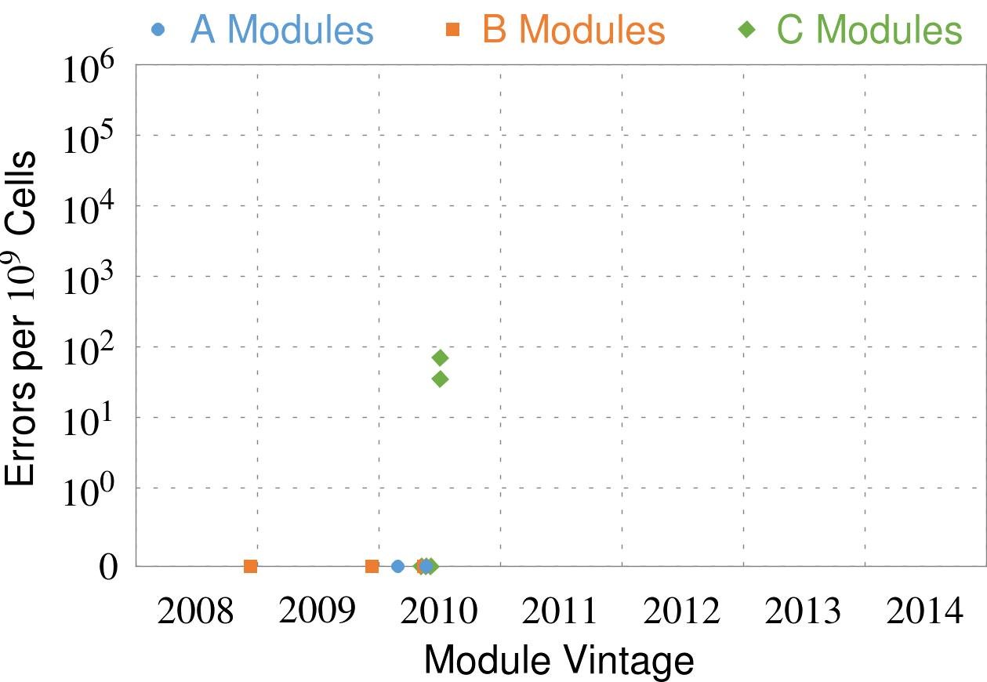
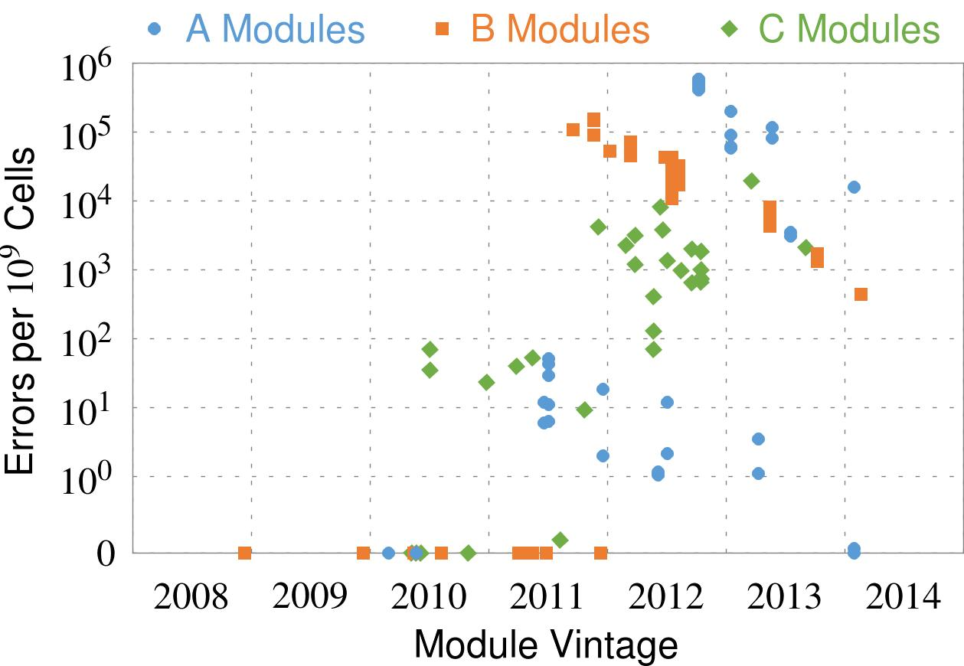
Errors vs. Vintage
First
Appearance
All modules from 2012–2013 are vulnerable
Notes:
In this figure, the x-axis is the module manufacture date. And the y-axis is the number of errors in a module, normalized to one billion cells. In 2008 and 2009, there are no errors. But, in 2010, we first start to see errors in C modules. After 2010, the errors start to proliferate. For A and B modules, we first start to see errors in 2011. In particular, all modules from 2012 and 2013 are vulnerable.

Slide 20
Characterization Results
Most Modules Are at Risk
Errors vs. Vintage
Error = Charge Loss
Adjacency: Aggressor & Victim
Sensitivity Studies
Other Results in Paper
Notes:
Now I will present the characterization results, one-by-one.
First, I show that most modules are at risk. Second, I show the number of errors in a module as a function of the manufacture date. Third, I show that the errors are symptomatic of charge loss. Fourth, I show that an aggressor induces errors in adjacent rows. Fifth, I show several sensitivity studies. And, finally, I briefly describe other results in the paper.

Slide 21
Several Potential Solutions
Cost
Make better DRAM chips
Power, Performance
Refresh frequently
Cost, Power
Sophisticated ECC
Cost, Power, Complexity
Access counters
Notes:
Here is a list of four potential solutions to disturbance errors: making better DRAM chips, refreshing more frequently, employing sophisticated ECC schemes, and using hardware counters to track the number of accesses to different rows.
However, all of these solutions incur a large overhead in terms cost, power, performance, and/or complexity.

Slide 22
Our Solution
PARA: Probabilistic Adjacent Row Activation
Key Idea
  After closing a row, we activate (i.e., refresh) one of its neighbors with a low probability: p = 0.005
Reliability Guarantee
  When p=0.005, errors in one year: 9.4×10⁻¹⁴
  By adjusting the value of p, we can provide an arbitrarily strong protection against errors
Notes:
We provide a more efficient solution, called PARA, which stands for probabilistic adjacent row activation.
The key idea is thus: after closing a row, we activate (i.e., refresh) one of its neighbors with a low probability, for example, p equal to 0.005.
PARA provides a strong reliability guarantee even under the worst-case access patterns to DRAM. When we set p to 0.005, the expected number of errors in one year is 9.4 times 10 to the negative 14. This probability is much lower the failure rate of other hardware components, for example, the hard-disk drive.
And by adjusting the value of p, PARA can provide an arbitrarily strong-degree of protection against errors.

Slide 23
More Information …
Yoongu Kim, Ross Daly, Jeremie Kim, Chris Fallin, Ji Hye Lee, Donghyuk Lee, Chris Wilkerson, Konrad Lai, and Onur Mutlu,
"Flipping Bits in Memory Without Accessing Them: An Experimental Study of DRAM Disturbance Errors"
Proceedings of the 41st International Symposium on Computer Architecture (ISCA), Minneapolis, MN, June 2014. Slides (pptx) (pdf) Lightning Session Slides (pptx) (pdf) Source Code and Data

Slide 24
Some New Ideas (This Year)
Specialization
  Heterogeneous Reliability Memory [DSN 2014]
  Heterogeneous Block Architecture [ICCD 2014]
Persistent Memory
  Loose Ordering Consistency for Persistent Memory [ICCD 2014]
  Transparent Consistency for Persistent/Hybrid Memory [in progress]
Memory Reliability/Security
  Row Hammer Problem in DRAM [ISCA 2014]
  Neighbor-Cell Assisted Error Correction in Flash [SIGMETRICS 2014]
  Error Mitigation for Intermittent DRAM Failures [SIGMETRICS 2014]
Memory Performance
  The Dirty-Block Index [ISCA 2014]
  DRAM Refresh-Access Parallelization [HPCA 2014]
  The Blacklisting Memory Scheduler [ICCD 2014]
  Exploiting Read-Write Disparity in Caches [HPCA 2014]

Slide 25


Characterizing Application
Memory Error Vulnerability to
Optimize Datacenter Cost via Heterogeneous-Reliability Memory
Yixin Luo, Sriram Govindan, Bikash Sharma,
Mark Santaniello, Justin Meza, Aman Kansal, Jie Liu,
Badriddine Khessib, Kushagra Vaid, Onur Mutlu
Notes:
Thank you for your introduction. I am very glad to be here to present our work “Characterizing Application Memory Error Vulnerability to Optimize Datacenter Cost via Heterogeneous-Reliability Memory”.
This work is done with my coauthors from Carnegie Mellon University and Microsoft.

Slide 26
Executive Summary
Problem: Reliable memory hardware increases cost
Our Goal: Reduce datacenter cost; meet availability target
Observation: Data-intensive applications’ data exhibit a diverse spectrum of tolerance to memory errors
  Across applications and within an application
  We characterized 3 modern data-intensive applications
Our Proposal: Heterogeneous-reliability memory (HRM)
  Store error-tolerant data in less-reliable lower-cost memory
  Store error-vulnerable data in more-reliable memory
Major results:
  Reduce server hardware cost by 4.7 %
  Achieve single server availability target of 99.90 %
Notes:
Here is a summary of our talk.
The focus of this work is on the trade-off between memory cost and reliability. Today’s servers typically rely on reliable memory hardware, which increases cost. So our goal is to find an optimal point in this tradeoff to reduce datacenter cost while meeting reliability target.
In this paper, we first characterized 3 new data-intensive workloads and observed that these applications have a diverse spectrum of tolerance to memory errors.
Based on this observation, we proposed heterogeneous-reliability memory, which stores error-tolerant data in less-reliable but lower-cost memories and stores error-vulnerable data in more reliable memories enabled by sw/hw cooperative techniques.
We evaluated an example HRM system which can reduce server hardware cost by 4.7% while achieving single server availability target of 99.90%. Note that this cost savings can mean million dollar for companies with large-scale datacenters.

Slide 27
Outline
Motivation
Characterizing application memory error tolerance
Key observations
  Observation 1: Memory error tolerance varies
  across applications and within an application
  Observation 2: Data can be recovered by software
Heterogeneous-Reliability Memory (HRM)
Evaluation
Notes:
Here is an outline of this talk.

Slide 28
Outline
Motivation
Characterizing application memory error tolerance
Key observations
  Observation 1: Memory error tolerance varies
  across applications and within an application
  Observation 2: Data can be recovered by software
Heterogeneous-Reliability Memory (HRM)
Evaluation
Notes:
First, let’s start with the motivation of our work.

Slide 29
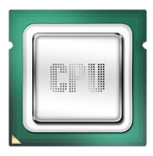
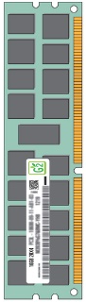
Server Memory Cost is High
Server hardware cost dominates datacenter Total Cost of Ownership (TCO) [Barroso ‘09]
As server memory capacity grows, memory cost becomes the most important component of server hardware costs [Kozyrakis ‘10]
128GB Memory cost
~$140(per 16GB)×8
= ~$1120 *
2 CPUs cost
~$500(per CPU)×2
= ~$1000 *
* Numbers in the year of 2014
Notes:
As we all know, many companies have been trying to reduce datacenter total cost of ownership.
Recent research has shown that server hardware cost dominates datacenter total cost of ownership.
In addition to that, as server memory capacity grows, memory cost can exceed CPU cost and become the most important component of server hardware cost.
For an example server running data-intensive applications with 128 GB memory and 2 CPUs, total memory cost can be higher than total CPU cost.

Slide 30
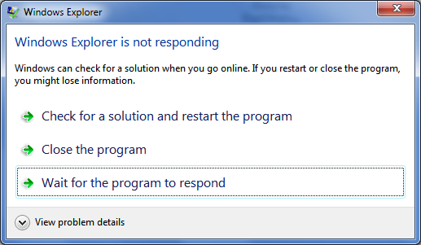


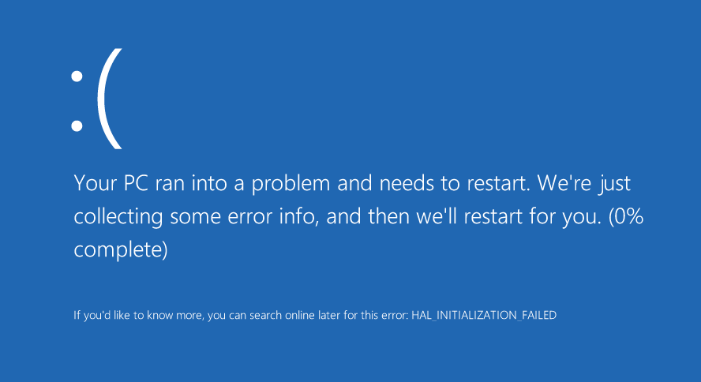
Memory Reliability is Important
System/app
hang or slowdown
System/app crash
Silent data corruption or incorrect app output
Notes:
Apart from memory cost, memory reliability is also important to datacenters.
Memory errors can cause system or applications to hang, slowdown, or crash.
Memory errors can also corrupt user data or generate incorrect application outputs.
To mitigate these memory errors,

Slide 31
Existing Error Mitigation Techniques (I)
Quality assurance tests increase manufacturing cost
Memory testing cost can be a significant
fraction of memory cost as memory capacity grows
Notes:
To mitigate these memory errors, various error mitigation techniques are pervasively adopted in server memories.
One technique is the quality assurance tests performed during the manufacturing process. This figure shows the trend how fraction of testing cost over memory cost grows when DRAM chip capacity increases.
We conclude from this figure that testing cost can become a significant fraction of memory cost when its capacity is high.

Slide 32
Existing Error Mitigation Techniques (II)
Error detection and correction increases system cost
Increasing strength
Technique | Detection | Correction | Added capacity | Added logic
NoECC | N/A | N/A | 0.00% | No
Parity | 1 bit | N/A | 1.56% | Low
SEC-DED | 2 bit | 1 bit | 12.5% | Low
Chipkill | 2 chip | 1 chip | 12.5% | High
Parity | 1 bit | N/A | 1.56%
SEC-DED | 2 bit | 1 bit | 12.5%
SEC-DED | 2 bit | 1 bit | 12.5% | Low
Chipkill | 2 chip | 1 chip | 12.5% | High
Stronger error protection techniques have higher cost
Notes:
Another technique is error detection and correction, which stores extra bits in memory and verifies and recovers from memory errors in memory controller using these bits.
The table below shows various error detection and correction techniques along with their associated capacity and logic overhead.
Note that these techniques are ranked with increasing strength of error protection capabilities, from Parity, SEC-DED, to chipkill.
However, this increase in error protection strength requires either extra capacity in memory or extra logic in memory controller.
Both of these overheads increase memory cost in datacenter servers.
We conclude that stronger error protection techniques have higher cost.
For these existing approaches to mitigate memory errors

Slide 33
Shortcomings of Existing Approaches
Uniformly improve memory reliability
  Observation 1: Memory error tolerance varies
  across applications and with an application
Rely only on hardware-level techniques
  Observation 2: Once a memory error is detected,
  most corrupted data can be recovered by software
Goal: Design a new cost-efficient memory system
that flexibly matches memory reliability
with application memory error tolerance
Notes:
For these existing approaches to mitigate memory errors, we identified that there are two major shortcomings that make them less cost-efficient. Limit their cost-efficiencies.
First, these approaches uniformly improve memory reliability. And second, these approaches rely only on hardware-level techniques.
However, as we will show you later, we find that, for data-intensive applications, memory error tolerance varies for different applications and for different data within an application. We also find that once memory error is detected by hardware, software is able to recover most of the corrupted data.
To overcome these shortcomings and take advantage of the opportunities, we set our goal to design a new cost-efficient memory system that can flexible match memory reliability with application memory error tolerance.
In the following part of this presentation, we will go into details about how we made these observations and how we exploited these observations to reach our goal.

Slide 34
Outline
Motivation
Characterizing application memory error tolerance
Key observations
  Observation 1: Memory error tolerance varies
  across applications and within an application
  Observation 2: Data can be recovered by software
Heterogeneous-Reliability Memory (HRM)
Evaluation
Notes:
As the first step towards our goal, we characterized application memory error tolerance.

Slide 35
Characterization Goal
Quantify application memory error tolerance
corrupted
Memory Error Outcomes
Memory Error
x = …010…
x = …110…
Store
Load
Masked by Overwrite
Consumed by Application
x = …000…
if (x != 0) …
Masked by Logic
Incorrect Response
System/App Crash
return x;
or
*x;
✓Correct Result
✗Incorrect Result
Notes:
The goal of our characterization is to quantify application memory error tolerance.
Before we go into details about our characterization, let’s first look at what are the possible outcomes of a memory error and how memory errors evolve into these outcomes.
When a memory error happens on a piece of data in memory, the data will be corrupted. However, if the next access to the corrupted data is a store, a clean data will overwrite the corrupted data and hence generate correct result. On the other hand, if the next access is a load, the corrupted data will be consumed by the application.
In some cases, application logic can mask the data corruption and still generate correct result. While in other cases, if the memory error affects application’s data or control flow, the user will get incorrect result.
In summary, the outcomes of a memory error can either be correct result or incorrect result.
We further breakdown incorrect result in our evaluation into the rate of incorrect query responses and the probability of system/application crash on the affected server.

Slide 36
Characterization Methodology
3 modern data-intensive applications
3 dominant memory regions
  Heap – dynamically allocated data
  Stack – function parameters and local variables
  Private – private heap managed by user
Injected a total of 23,718 memory errors using software debuggers (WinDbg and GDB)
Examined correctness for over 4 billion queries
Application | WebSearch | Memcached | GraphLab
Memory footprint | 46 GB | 35 GB | 4 GB
Notes:
In order to quantify memory error outcomes, we characterized 3 modern data-intensive applications.
WebSearch is an interactive web search workload with 46 GB memory footprint.
Memcached is an in-memory key-value store with 35 GB memory footprint.
GraphLab is a graph mining workload with 4 GB memory footprint.
We further breakdown each application into 3 dominant memory regions, heap, stack and private region.
We use software debuggers to inject memory errors one at a time uniformly to the entire application memory space.
In total, we injected more than 23 thousand memory errors and examined correctness for over 4 billion queries.
Please note that the number of injected errors are used to calculate 90% confidence interval of our characterized probabilities, which we will show can achieve reasonable confidence interval.
Backup slides
Error in each application
Qps of each application

Slide 37
Outline
Motivation
Characterizing application memory error tolerance
Key observations
  Observation 1: Memory error tolerance varies
  across applications and within an application
  Observation 2: Data can be recovered by software
Heterogeneous-Reliability Memory (HRM)
Evaluation
Notes:
Next we will present our characterization results and key observations.

Slide 38
Observation 1: Memory Error Tolerance Varies
Across Applications
>10× difference
Showing results for single-bit soft errors
Results for other memory error types can be found in the paper with similar conclusion
Notes:
The first observation from the result is memory error tolerance varies across applications.
This figure shows the probability of system or application crash in case of a single-bit soft error for the 3 characterized applications.
The error bars on the figure shows the 90% confidence interval of each probability.
As we can see, probability of crash varies as much as 10 times across applications.
While today we will only present single-bit soft error results, we have results for other error types including multi-bit soft and hard errors in the paper and the conclusion is similar.

Slide 39
Observation 1: Memory Error Tolerance Varies
Across Applications
>10⁵× difference
Showing results for single-bit soft errors
Results for other memory error types can be found in the paper
Notes:
This is another figure that shows the rate of incorrect responses for the 3 characterized applications.
y-axis is the number of incorrect responses per billion queries in log scale.
Error bars on the figure show the maximum incorrect queries we have observed in an experiment.
As we can see from this figure, rate of incorrect responses varies up to 5 orders of magnitude
Axis don’t use 1.0E+x

Slide 40
Observation 1: Memory Error Tolerance Varies
Across Applications
and Within an Application
>4× difference
Showing results for WebSearch
Results for other workloads can be found in the paper
Notes:
Not only does memory error tolerance varies across applications, but it also varies within an application.
We examined WebSearch as an example, and this figure shows how system or application crash probability varies over different memory regions for WebSearch.
We can see from this figure that a memory error in private memory region is 4 times more probable to result in a crash than a memory error in the stack region.

Slide 41
Observation 1: Memory Error Tolerance Varies
Across Applications
and Within an Application
All averaged at a very low rate
15
Showing results for WebSearch
Results for other workloads can be found in the paper
Notes:
This is another figure that shows incorrect response rates for different memory regions within an application.
Although we only see 1 order of magnitude difference in incorrect response rate, we can see that these incorrect responses all happens at a very low rate.
In fact, many data intensive applications can tolerate a low rate of incorrect responses. These applications include websearch, some in-memory key-value store application such as twitter, and many data mining applications.

Slide 42
Outline
Motivation
Characterizing application memory error tolerance
Key observations
  Observation 1: Memory error tolerance varies
  across applications and within an application
  Observation 2: Data can be recovered by software
Heterogeneous-Reliability Memory (HRM)
Evaluation
Notes:
Observation 2: Let me now discuss our second key observation.

Slide 43
Observation 2: Data Can be Recovered by Software
Implicitly and Explicitly
Implicitly recoverable – application intrinsically has a clean copy of the data on disk
Explicitly recoverable – application can create a copy of the data at a low cost (if it has very low write frequency)
Notes:
The second observation we made is that many data can be recovered by software implicitly and explicitly and there are great potential in both.
If the application intrinsically has a clean copy of the data on disk, then we consider it as implicitly recoverable.
If the application can create a copy of the data at a low cost, then we consider it as explicitly recoverable.
The figure below shows WebSearch recoverability which we characterized as an example.
We can see that there is a significant opportunity for software recovery.
82% of websearch address space is implicitly recoverable and 56% is explicitly recoverable.

Slide 44
Outline
Motivation
Characterizing application memory error tolerance
Key observations
  Observation 1: Memory error tolerance varies
  across applications and within an application
  Observation 2: Data can be recovered by software
Heterogeneous-Reliability Memory (HRM)
Evaluation
Notes:
Next, we will explain our mechanisms to exploit these observations to achieve our goal

Slide 45
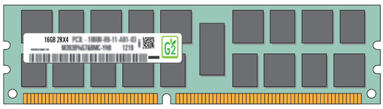
Exploiting Memory Error Tolerance
Heterogeneous-Reliability Memory
Vulnerable data
Vulnerable data
Tolerant data
Tolerant data
Reliable memory
Low-cost memory
Vulnerable data
ECC protected
Well-tested chips
Tolerant data
NoECC or Parity
Less-tested chips
Notes:
As we have shown earlier, either across or within applications, our characterization can identify data that are vulnerable to memory errors and data that are tolerant to memory errors.
To exploit this observation, we would like to map these different data onto different memory modules according to their memory error tolerance.
As an example here, we map vulnerable data to reliable memory to improve reliability, and map tolerant data to low-cost less-reliable memory to exploit its tolerance and lower the cost. We call this mechanism heterogeneous-reliability memory, HRM.
Reliable memory consists of … Low cost memory consists of …
As we will show later, HRM allows us to use weaker error protection in memory, and enables the use of less-tested memory chips to lower the cost of the memory system, while still achieving reasonable single-server reliability target.

Slide 46
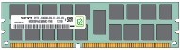
Par+R: Parity Detection + Software Recovery
Implicit Recovery
Explicit Recovery
Memory
Memory
Page A
Page A
Page B
Page B
Page B
Memory Error
Memory Error
Write
Copy
Copy
Disk
Disk
Page A
Page A
✓
✓
✗
Intrinsic copy
Write non-intensive
Write intensive
Notes:
As we have also observed earlier, there is a great potential in using software to recover a corrupted data from a copy.
To exploit this observation, we apply Par+R, which stands for Parity detection + software recovery to part of data that are recoverable.
As we have described, if a page has an intrinsic copy of its data in the disk, we use parity memory to detect memory errors in hardware and then correct the error in software by recovering from the disk.
For explicit recovery, we first create a copy of the data by copying the page to disk. Then similarly, we use parity hardware to detect the error and recover with software from the disk.
In order to keep a clean copy of the data, we need to copy the page whenever there is a write to the memory. This can create a high enough overhead so that we do not consider write intensive data as explicitly recoverable.
In conclusion, Par+R can detect and correct a memory error with a low software and hardware overhead.

Slide 47
Heterogeneous-Reliability Memory
App 1 data A
App 1 data B
App 2 data A
App 2 data B
App 3 data A
App 3 data B
Step 1: Characterize and classify application memory error tolerance
App 1 data A
App 2 data A
App 2 data B
App 1 data B
App 3 data A
App 3 data B
Vulnerable
Tolerant
Step 2: Map application data to the HRM system enabled by SW/HW cooperative solutions
Reliable
Unreliable
Reliable memory
Parity memory
+ software recovery (Par+R)
Low-cost memory
Notes:
Now we have described the key idea of HRM and Par+R, let’s look at our mechanism to put them together.
First, we characterize and classify application data in terms of their memory error tolerance, rank them from vulnerable to tolerant.
Then, we map application data to HRM according to their error tolerance. As an example here, vulnerable data is mapped to reliable memory, tolerable data is mapped to low-cost memory, and recoverable data is mapped to parity memory with Par+R.

Slide 48
Outline
Motivation
Characterizing application memory error tolerance
Key observations
  Observation 1: Memory error tolerance varies
  across applications and within an application
  Observation 2: Data can be recovered by software
Heterogeneous-Reliability Memory (HRM)
Evaluation
Notes:
Next, let’s look at our evaluation of our example HRM systems.

Slide 49
Evaluated Systems
Configuration | Mapping |  |  | Pros and Cons
 | Private (36 GB) | Heap (9 GB) | Stack (60 MB)
Typical Server | ECC | ECC | ECC | Reliable but expensive
Consumer PC | NoECC | NoECC | NoECC | Low-cost but unreliable
HRM | Par+R | NoECC | NoECC | Parity only
Less-Tested (L) | NoECC | NoECC | NoECC | Least expensive and reliable
HRM/L | ECC | Par+R | NoECC | Low-cost and reliable HRM
Baseline systems
HRM systems
Notes:
In this table, we listed 5 different configurations.
They differ in how they map their data to different memory.
The first 3 configurations uses well-tested memory.
Typical server applies ECC uniformly for all data. Consumer PC applies NoECC for all data. HRM applies Par+R for Private memory and NoECC for the rest.
The next two configurations uses less-tested memory. Less-tested L applies NoECC and is hence least expensive but also least reliable.
HRM/L is our proposed system which applies HRM design to less-tested memory.

Slide 50
Design Parameters
DRAM/server HW cost [Kozyrakis ‘10] | 30%
NoECC memory cost savings | 11.1%
Parity memory cost savings | 9.7%
Less-tested memory cost savings | 18%±12%
Crash recovery time | 10 mins
Par+R flush threshold | 5 mins
Errors/server/month [Schroeder ‘09] | 2000
Target single server availability | 99.90%
Notes:
Here is a list of our design parameters and assumptions.
We use numbers from recent academic paper and assume memory cost accounts for 30% of the total server hardware cost. We also assume a typical server suffers 2000 errors per month. And our target single server availability is 99.90%.

Slide 51
Evaluation Metrics
Cost
  Memory cost savings
  Server HW cost savings
  (both compared with Typical Server)
Reliability
  Crashes/server/month
  Single server availability
  # incorrect/million queries
Notes:
Here is our evaluation metrics which can be grouped into 2 categories. Each corresponds to the goal of our work – cost and reliability.
For the cost metric, we evaluated memory cost savings and server hardware cost savings, both compared with typical server.
For the reliability metric, we evaluated probability of crash and incorrect query rate and single server availability.
Let’s first take a look at two most representative metrics – server hardware cost savings and single server availability.

Slide 52
Improving Server HW Cost Savings
Reducing the use of memory error mitigation techniques in part of memory space can save noticeable amount of server HW cost
Notes:
This figure shows the result for server hardware cost savings. The first HRM system can achieve 2.9% cost savings and the HRM/L system can improve cost savings to 4.7%.
As we can see, reducing even part of memory error mitigation techniques can improve server hardware cost savings.

Slide 53
Achieving Target Availability
Single server availability target: 99.90%
✓
✓
✓
✗
✗
HRM systems are flexible to adjust
and can achieve availability target
Notes:
This figure shows single server availability for different evaluated system.
Note that single server availability is different from application availability which directly affects the end users.
Single server failure can be largely masked by existing application level fault tolerant techniques
Going back to the figure, the dotted line shows our single server availability target.
As we can see, both HRM systems are able to achieve the availability target.
Hence we can conclude that HRM systems are flexible to adjust and achieve availability target.

Slide 54
Achieving Acceptable Correctness
HRM systems can achieve acceptable correctness
Notes:
This figure shows incorrect response rates for 5 configurations.
Y axis is number of incorrect responses per million queries in log scale.
As we can see, both HRM systems can achieve acceptable correctness.

Slide 55
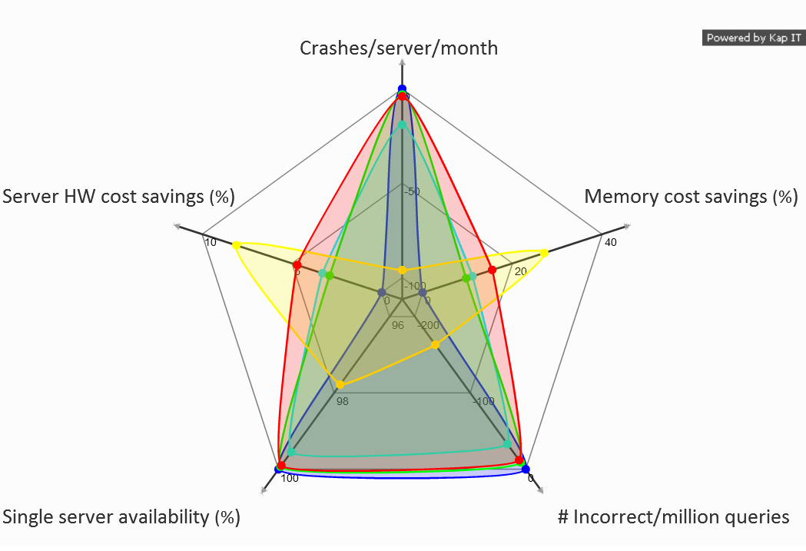
Evaluation Results
Typical Server
Consumer PC
HRM
Less-Tested (L)
HRM/L
Inner is worse
Outer is better
Bigger area means better tradeoff
Notes:
Here is a radar graph for all 5 metrics and systems.
Each axis represents one of the metrics, each closed curve represents the results of the system its color stands for.
We show crashes and incorrect query rates in negative numbers so that, for all of the axes, outer is better.
We conclude that our HRM systems have the largest areas.

Slide 56
Other Results and Findings
Characterization of applications’ reactions to memory errors
  Finding: Quick-to-crash vs. periodically incorrect behavior
Characterization of most common types of memory errors including single-bit soft/hard errors, multi-bit hard errors
  Finding: More severe errors mainly decrease correctness
Characterization of how errors are masked
  Finding: Some memory regions are safer than others
Discussion about heterogeneous reliability design dimensions, techniques, and their benefits and tradeoffs
Notes:
We have many other interesting results in the paper including characterization of applications’ reaction to memory errors, other memory error types, how errors are masked, and discussion about HRM design dimensions.

Slide 57
Conclusion
Our Goal: Reduce datacenter cost; meet availability target
Characterized application-level memory error tolerance of 3 modern data-intensive workloads
Proposed Heterogeneous-Reliability Memory (HRM)
  Store error-tolerant data in less-reliable lower-cost memory
  Store error-vulnerable data in more-reliable memory
Evaluated example HRM systems
  Reduce server hardware cost by 4.7 %
  Achieve single-server availability target 99.90 %
Notes:
As a conclusion of the talk, we achieved our goal to reduce datacenter cost and meet availability target by characterizing application memory error tolerance and applying proposed heterogeneous reliability memory (HRM).
We also evaluated example HRM systems and showed the benefit.

Slide 58
More Information …
Yixin Luo, Sriram Govindan, Bikash Sharma, Mark Santaniello, Justin Meza, Aman Kansal, Jie Liu, Badriddine Khessib, Kushagra Vaid, and Onur Mutlu,
"Characterizing Application Memory Error Vulnerability to Optimize Data Center Cost via Heterogeneous-Reliability Memory"
Proceedings of the 44th Annual IEEE/IFIP International Conference on Dependable Systems and Networks (DSN), Atlanta, GA, June 2014. Slides (pptx) (pdf) Coverage on ZDNet

Slide 59
Some New Ideas (This Year)
Specialization
  Heterogeneous Reliability Memory [DSN 2014]
  Heterogeneous Block Architecture [ICCD 2014]
Persistent Memory
  Loose Ordering Consistency for Persistent Memory [ICCD 2014]
  Transparent Consistency for Persistent/Hybrid Memory [in progress]
Memory Reliability/Security
  Row Hammer Problem in DRAM [ISCA 2014]
  Neighbor-Cell Assisted Error Correction in Flash [SIGMETRICS 2014]
  Error Mitigation for Intermittent DRAM Failures [SIGMETRICS 2014]
Memory Performance
  The Dirty-Block Index [ISCA 2014]
  DRAM Refresh-Access Parallelization [HPCA 2014]
  The Blacklisting Memory Scheduler [ICCD 2014]
  Exploiting Read-Write Disparity in Caches [HPCA 2014]

Slide 60
Some New Ideas in Memory System Design for Data-Intensive Computing
Onur Mutlu
onur@cmu.edu
September 4, 2014
ISTC-CC Retreat

Slide 61
Backup Slides

Slide 62
The Dirty-Block Index

Slide 63


The Dirty-Block Index
ISCA 2014
Vivek Seshadri
Abhishek Bhowmick ∙ Onur Mutlu
Phillip B. Gibbons ∙ Michael A. Kozuch ∙ Todd C. Mowry
Notes:
For any piece of information, if there is a mismatch in the way it is organized and they way it is queried, inefficiency creeps in.

Slide 64

Mismatch: Representation and Query
Sorted by Title
A
B
Get all the books written by author X
C
…
Z
Notes:
For example, sorting a set of books based on the title is a bad approach if we frequently query for books written by specific authors.

Slide 65
Mismatch: Representation and Query
a
b
c
Breadth First
Search
d
e
0 | 1 | 0 | 0 | 0
1 | 0 | 1 | 1 | 0
0 | 1 | 0 | 0 | 0
0 | 1 | 0 | 0 | 1
0 | 0 | 0 | 1 | 0
List all edges
adjacent to
vertex ‘a’
Notes:
Similarly, representing a graph as a adjacency matrix is bad if we frequently perform breadth first search on the graph.

Slide 66
Mismatch: Representation and Query
Cache Tag Store
List all dirty blocks of DRAM row R.
D
Tag
D
Tag
D
Tag
D
Tag
D
Tag
D
Tag
D
Tag
D
Tag
Is block X
dirty?
Dirty Bit
Notes:
In this work, we find that there is a similar mismatch in the way the dirty bit information is organized in existing caches and the way it is queried.

Slide 67
Dirty-Block Index
Cache Tag Store
List all dirty blocks of DRAM row R.
Tag
Tag
Tag
Tag
Tag
Tag
Tag
Tag
Is block X
dirty?
DBI
Notes:
We propose a new way of organizing the dirty bit information in a structure called the Dirty-block index.

Slide 68
Application: DRAM-Aware Writeback
Virtual Write Queue [ISCA 2010], DRAM-Aware Writeback [TR-HPS-2010-2]
DRAM
Last-Level Cache
Memory Controller
Channel
Write Buffer
1. Buffer writes and flush them in a burst
Row Buffer
2. Row buffer hits are faster and more efficient than row misses

Slide 69
Application: DRAM-Aware Writeback
Virtual Write Queue [ISCA 2010], DRAM-Aware Writeback [TR-HPS-2010-2]
Last-Level Cache
Dirty Block
Memory Controller
Proactively write back
all other dirty blocks from
the same DRAM row
R
R
R
R
R
Significantly increases the DRAM write row hit rate
Get all dirty blocks of DRAM row ‘R’

Slide 70
Shortcoming of Block-Oriented Organization
Get all dirty blocks of DRAM row ‘R’
Set of blocks co-located in DRAM
~8KB = 128 cache blocks
Cache
Tag Store
Is block 1 of Row R dirty?
Is block 2 of Row R dirty?
Is block 3 of Row R dirty?
…
Is block 128 of Row R dirty?

Slide 71
The Dirty-Block Index (DBI)
Block Address
V
D
Sh
Repl
ECC
Cache
Tag Store
DBI
Tag Entry
DRAM row-oriented organization
of dirty bits

Slide 72
DRAM-Aware Writeback w/ DBI
1
Virtual Write Queue [ISCA 2010], DRAM-Aware Writeback [TR-HPS-2010-2]
Last-Level Cache
Dirty Block
Proactively write back
all other dirty blocks from the same DRAM row
DBI achieves the benefit of DRAM-aware writeback without increasing contention for the tag store!
R
1
1
0
0
0
1
0
1
0
DBI
Look up the cache only for these blocks

Slide 73
Many Optimizations
DRAM-aware writeback
Bypassing cache lookups
Reducing ECC overhead
Efficient cache flushing
Load balancing memory accesses
Bulk DMA
Efficient write scheduling
...
DBI
Notes:
By eliminating the mismatch, our new organization enables simpler and more efficient implementations of several previously proposed optimizations.

Slide 74
Many Optimizations
DRAM-aware writeback
Bypassing cache lookups
Reducing ECC overhead
Efficient cache flushing
Load balancing memory accesses
Bulk DMA
Efficient write scheduling
...
DBI
31% performance over baseline
6% over best previous mechanism
8% cache area reduction
Notes:
With just three optimizations, our organization can improve performance by 31% compared to the baseline, 6% over the best previous mechanism while reducing overall cache area by 8% --- all with one structure.

Slide 75
More Information …
Vivek Seshadri, Abhishek Bhowmick, Onur Mutlu, Phillip B. Gibbons, Michael A. Kozuch, and Todd C. Mowry,
"The Dirty-Block Index"
Proceedings of the 41st International Symposium on Computer Architecture (ISCA), Minneapolis, MN, June 2014. Slides (pptx) (pdf) Lightning Session Slides (pptx) (pdf)

Slide 76
Refresh-Access Parallelization

Slide 77


Refresh Penalty
DRAM
Access
transistor
Memory Controller
Processor
Refresh
Read
Refresh interferes with memory accesses
Data
Capacitor
Refresh delays requests by 100s of ns

Slide 78
Existing Refresh Modes
All-bank refresh in commodity DRAM (DDRx)
Time
Bank 7
Refresh
…
Bank 1
Bank 0
Per-bank refresh allows accesses to other banks while a bank is refreshing
Per-bank refresh in mobile DRAM (LPDDRx)
Round-robin order
Time
Bank 7
…
…
Bank 1
Bank 0

Slide 79
Shortcomings of Per-Bank Refresh
Problem 1: Refreshes to different banks are scheduled in a strict round-robin order
  The static ordering is hardwired into DRAM chips
  Refreshes busy banks with many queued requests when other banks are idle
Key idea: Schedule per-bank refreshes to idle banks opportunistically in a dynamic order

Slide 80
Our First Approach: DARP
Dynamic Access-Refresh Parallelization (DARP)
  An improved scheduling policy for per-bank refreshes
  Exploits refresh scheduling flexibility in DDR DRAM
Component 1: Out-of-order per-bank refresh
  Avoids poor static scheduling decisions
  Dynamically issues per-bank refreshes to idle banks
Component 2: Write-Refresh Parallelization
  Avoids refresh interference on latency-critical reads
  Parallelizes refreshes with a batch of writes

Slide 81
Shortcomings of Per-Bank Refresh
Problem 2: Banks that are being refreshed cannot concurrently serve memory requests
Delayed by refresh
Bank 0
Per-Bank Refresh
RD
Time

Slide 82
Shortcomings of Per-Bank Refresh
Problem 2: Refreshing banks cannot concurrently serve memory requests
Key idea: Exploit subarrays within a bank to parallelize refreshes and accesses across subarrays
Bank 0
Subarray 1
RD
Time
Time
Subarray 0
Subarray Refresh
Parallelize

Slide 83
Methodology
Simulator configurations
Bank 7
DDR3 Rank
…
Memory Controller
Bank 1
Bank 0
8-core
processor
Memory Controller
L1 $: 32KB
L2 $: 512KB/core
100 workloads: SPEC CPU2006, STREAM, TPC-C/H, random access
System performance metric: Weighted speedup

Slide 84
Comparison Points
All-bank refresh [DDR3, LPDDR3, …]
Per-bank refresh [LPDDR3]
Elastic refresh [Stuecheli et al., MICRO ‘10]:
  Postpones refreshes by a time delay based on the predicted rank idle time to avoid interference on memory requests
  Proposed to schedule all-bank refreshes without exploiting per-bank refreshes
  Cannot parallelize refreshes and accesses within a rank
Ideal (no refresh)

Slide 85
System Performance
7.9%
12.3%
20.2%
1. Both DARP & SARP provide performance gains and combining them (DSARP) improves even more
2. Consistent system performance improvement across DRAM densities (within 0.9%, 1.2%, and 3.8% of ideal)

Slide 86
Energy Efficiency
5.2%
9.0%
3.0%
Consistent reduction on energy consumption

